Slide 1
Erasmus+
CLICK-CONTEMPORARY LITERACY IN CONTEMPORARY KIDS
FIVE DAYS IN VARDE-DENMARK AT 10iCampus

Slide 2
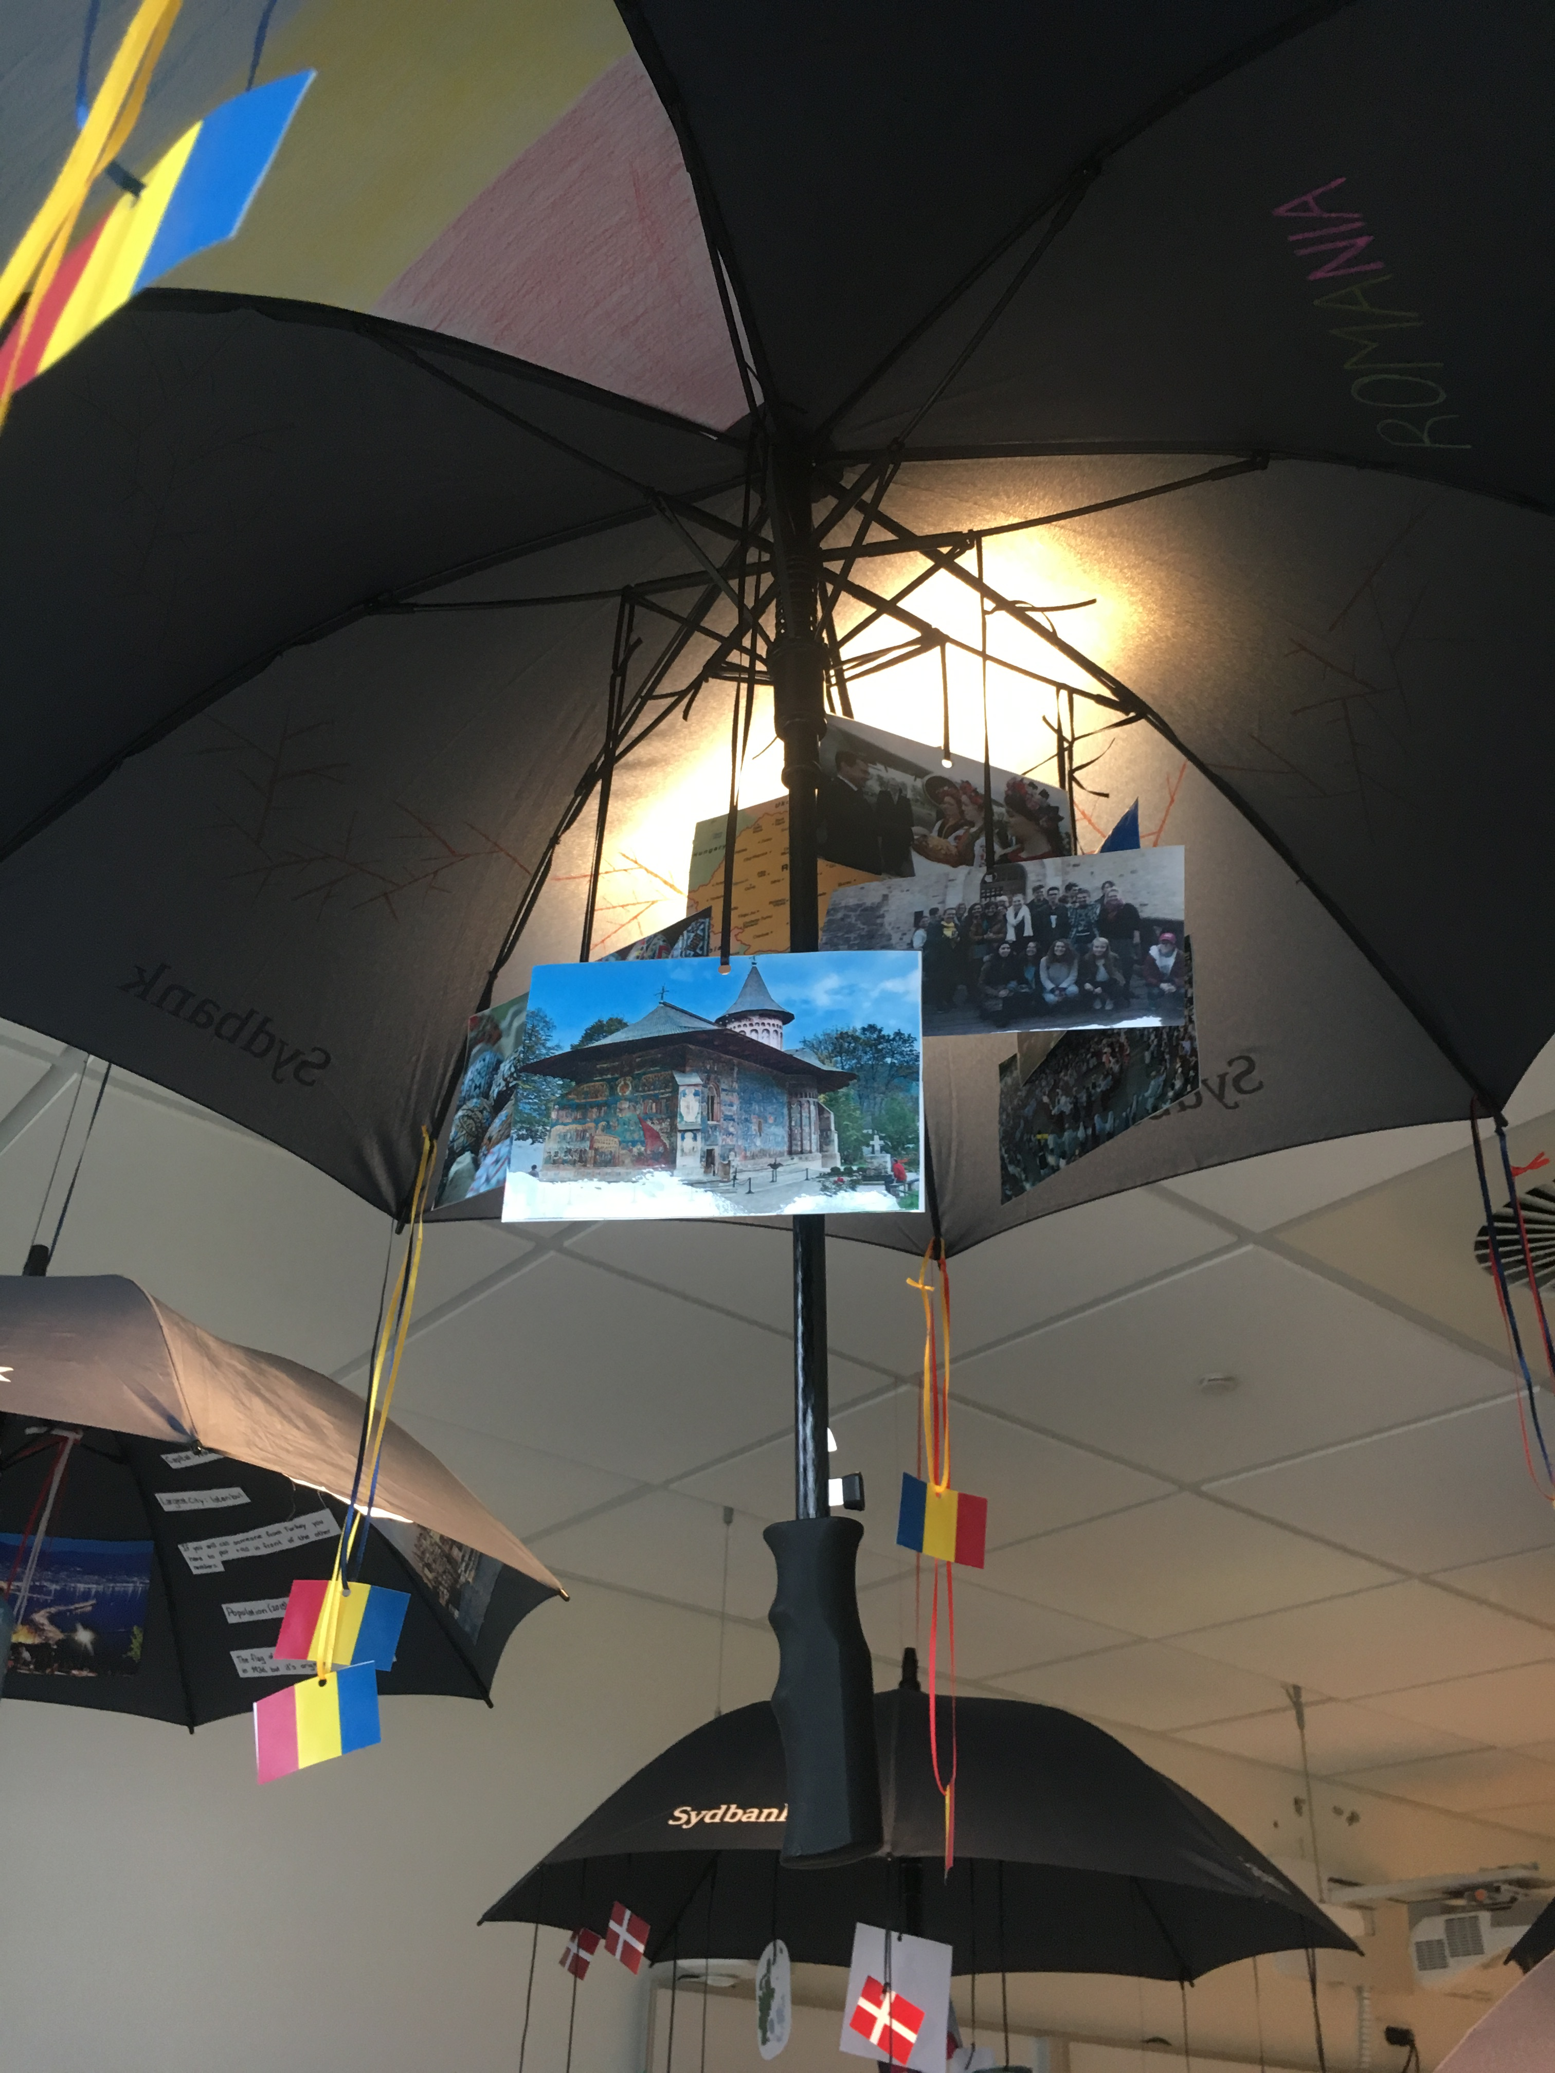
MONDAY
The 27th of March
The first day in Varde starts with a official oppening of the 3rd LTTA.
The teachers and students from Denmark made an umbrella for each country with representative images, named "Cultural Ceiling"

Slide 3
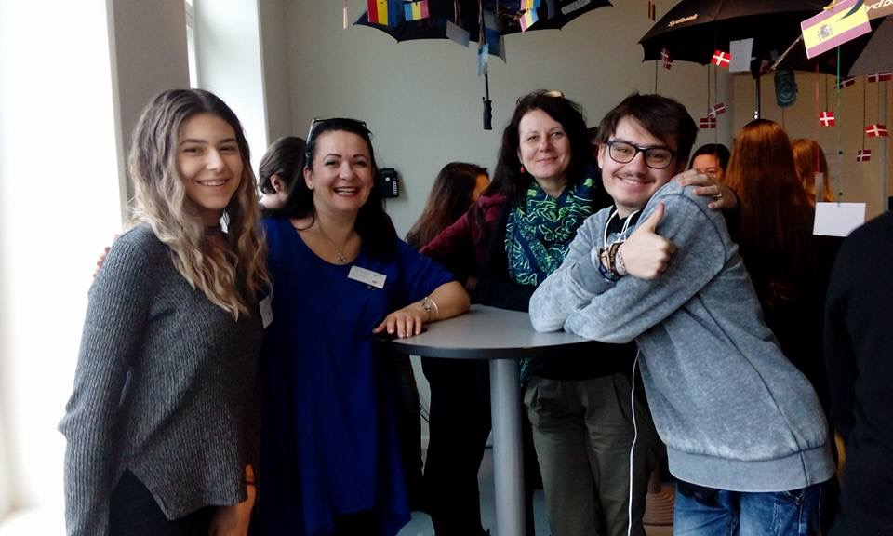
Team Romania and the umrellas

Slide 4
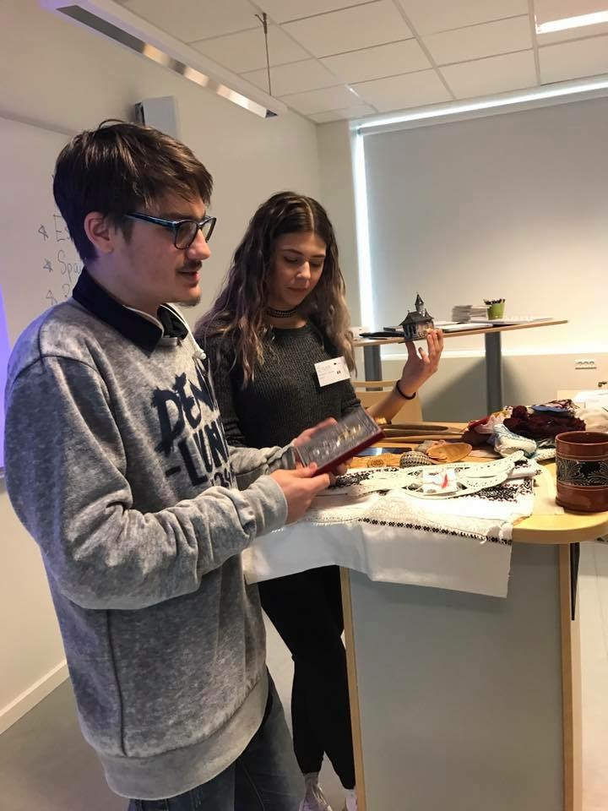
We visited the Varde Campus facilities and I was impressed. The school is huge, modern and with a lot of places for recreation.
After all the introduction, each country had a presentation: "My country in a bag" where we had to showed the people some things representative like: traditional costume, language, traditions.

Slide 5
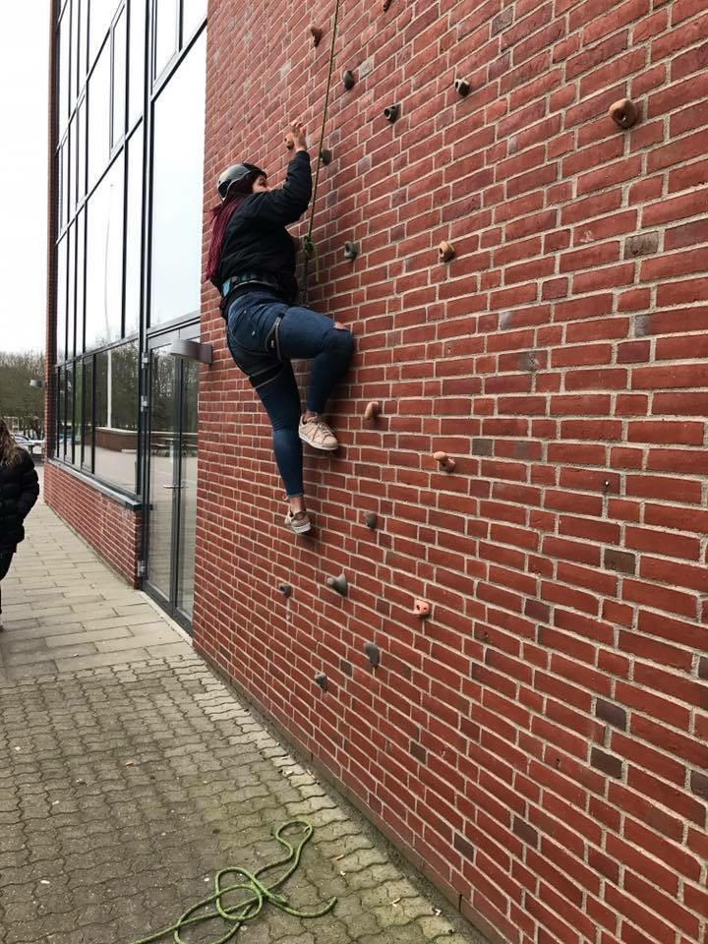
Team building in the surroundings of Varde Campus
We had to be a team, we had to work together to win and my team works so hard that we won the competition and I am proud.
We climbed buildings, we hauled water with small containers to fill a tube with holes, we transported each other on stretcher and a lot of these type of activities.

Slide 6
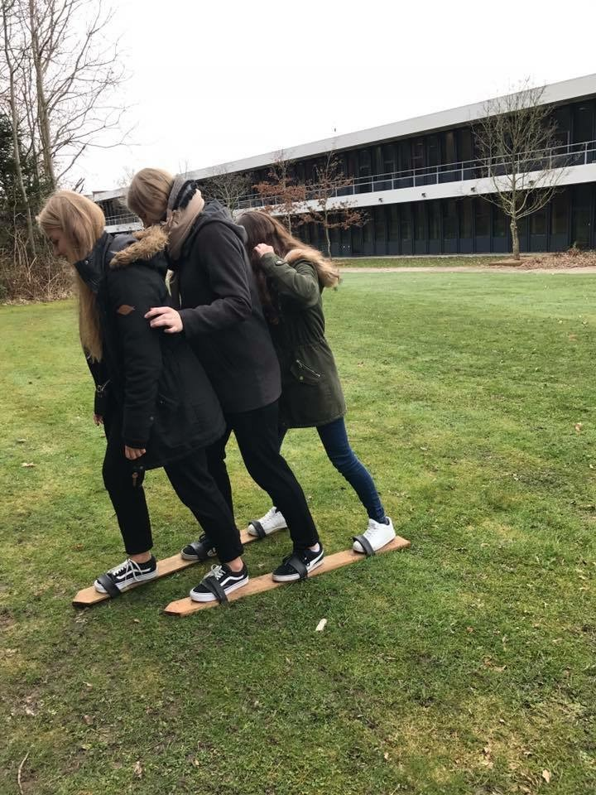
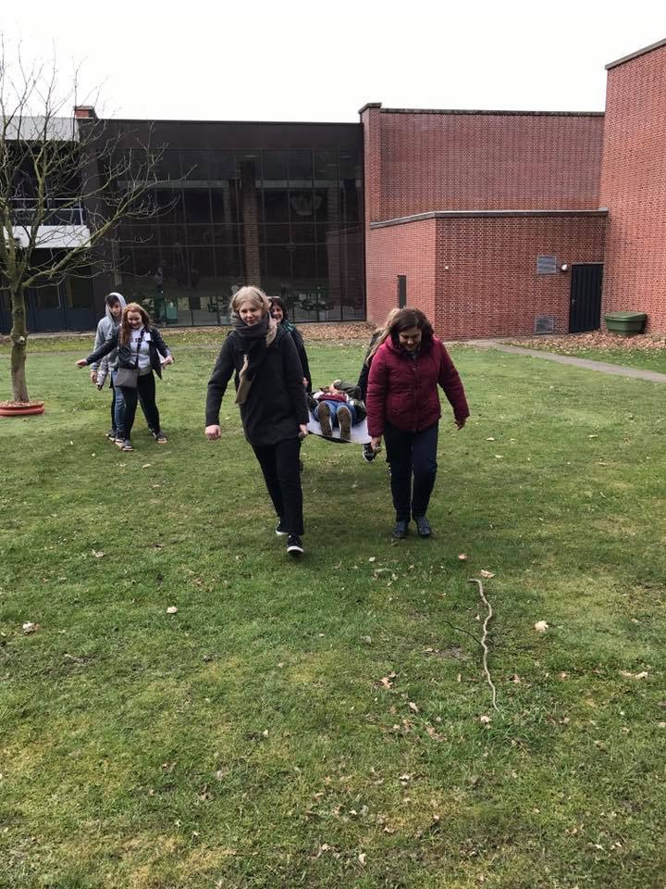

Slide 7
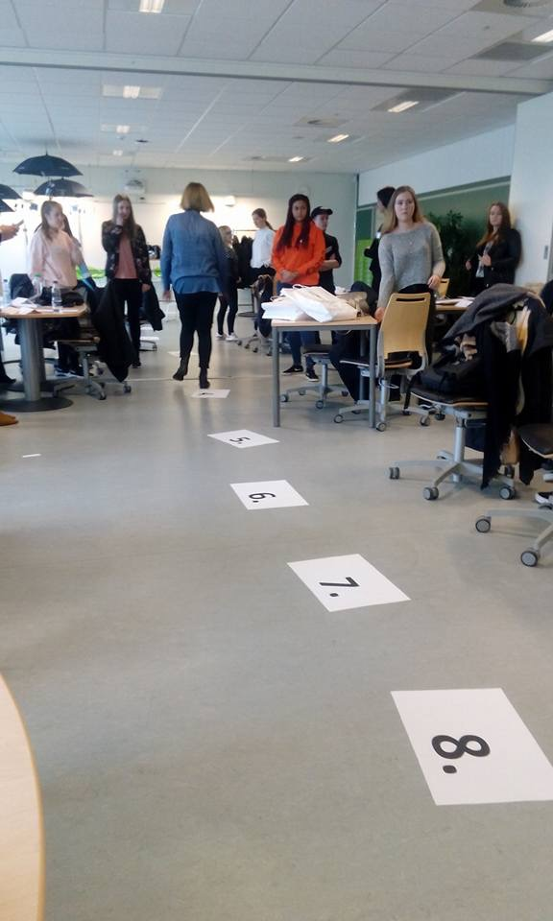
TUESDAY
The 28th of March
INTERCULTURAL LITERACY: We had to answer to some questions and on the floor we had grades from 1 to 10, we need to put us on the grade who show how important is for us the vote or the religion mixed with policy. Here we saw how everyone thinks and what opinions we have.

Slide 8
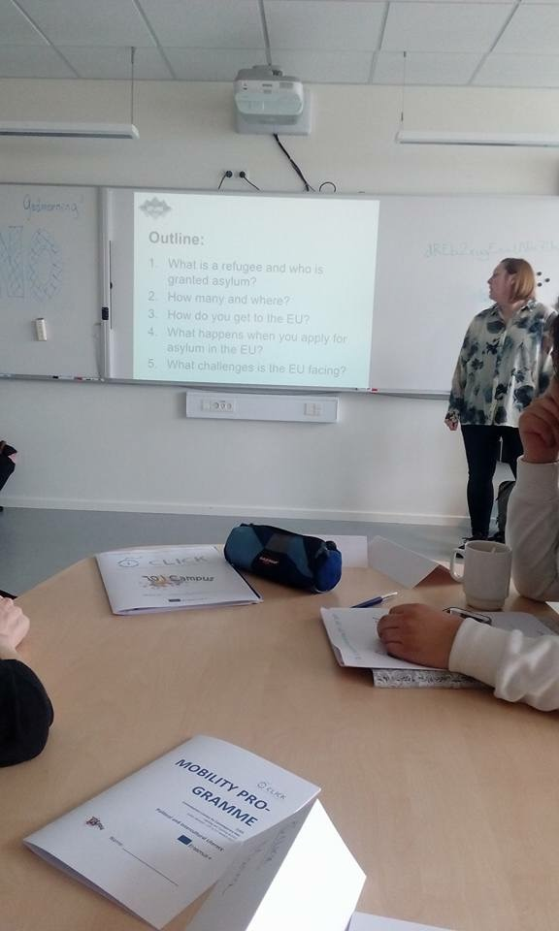
1st CASE STUDY
Two persons came to gives us an introductory presentation about asylum policy, EU's handling of the refugees, intercultural awareness. They show as the PBL-method. In this presentation we had some objectives: to leard what is a refugee and who is granted asylum, how many and where are the refugees, how EU helps them.

Slide 9
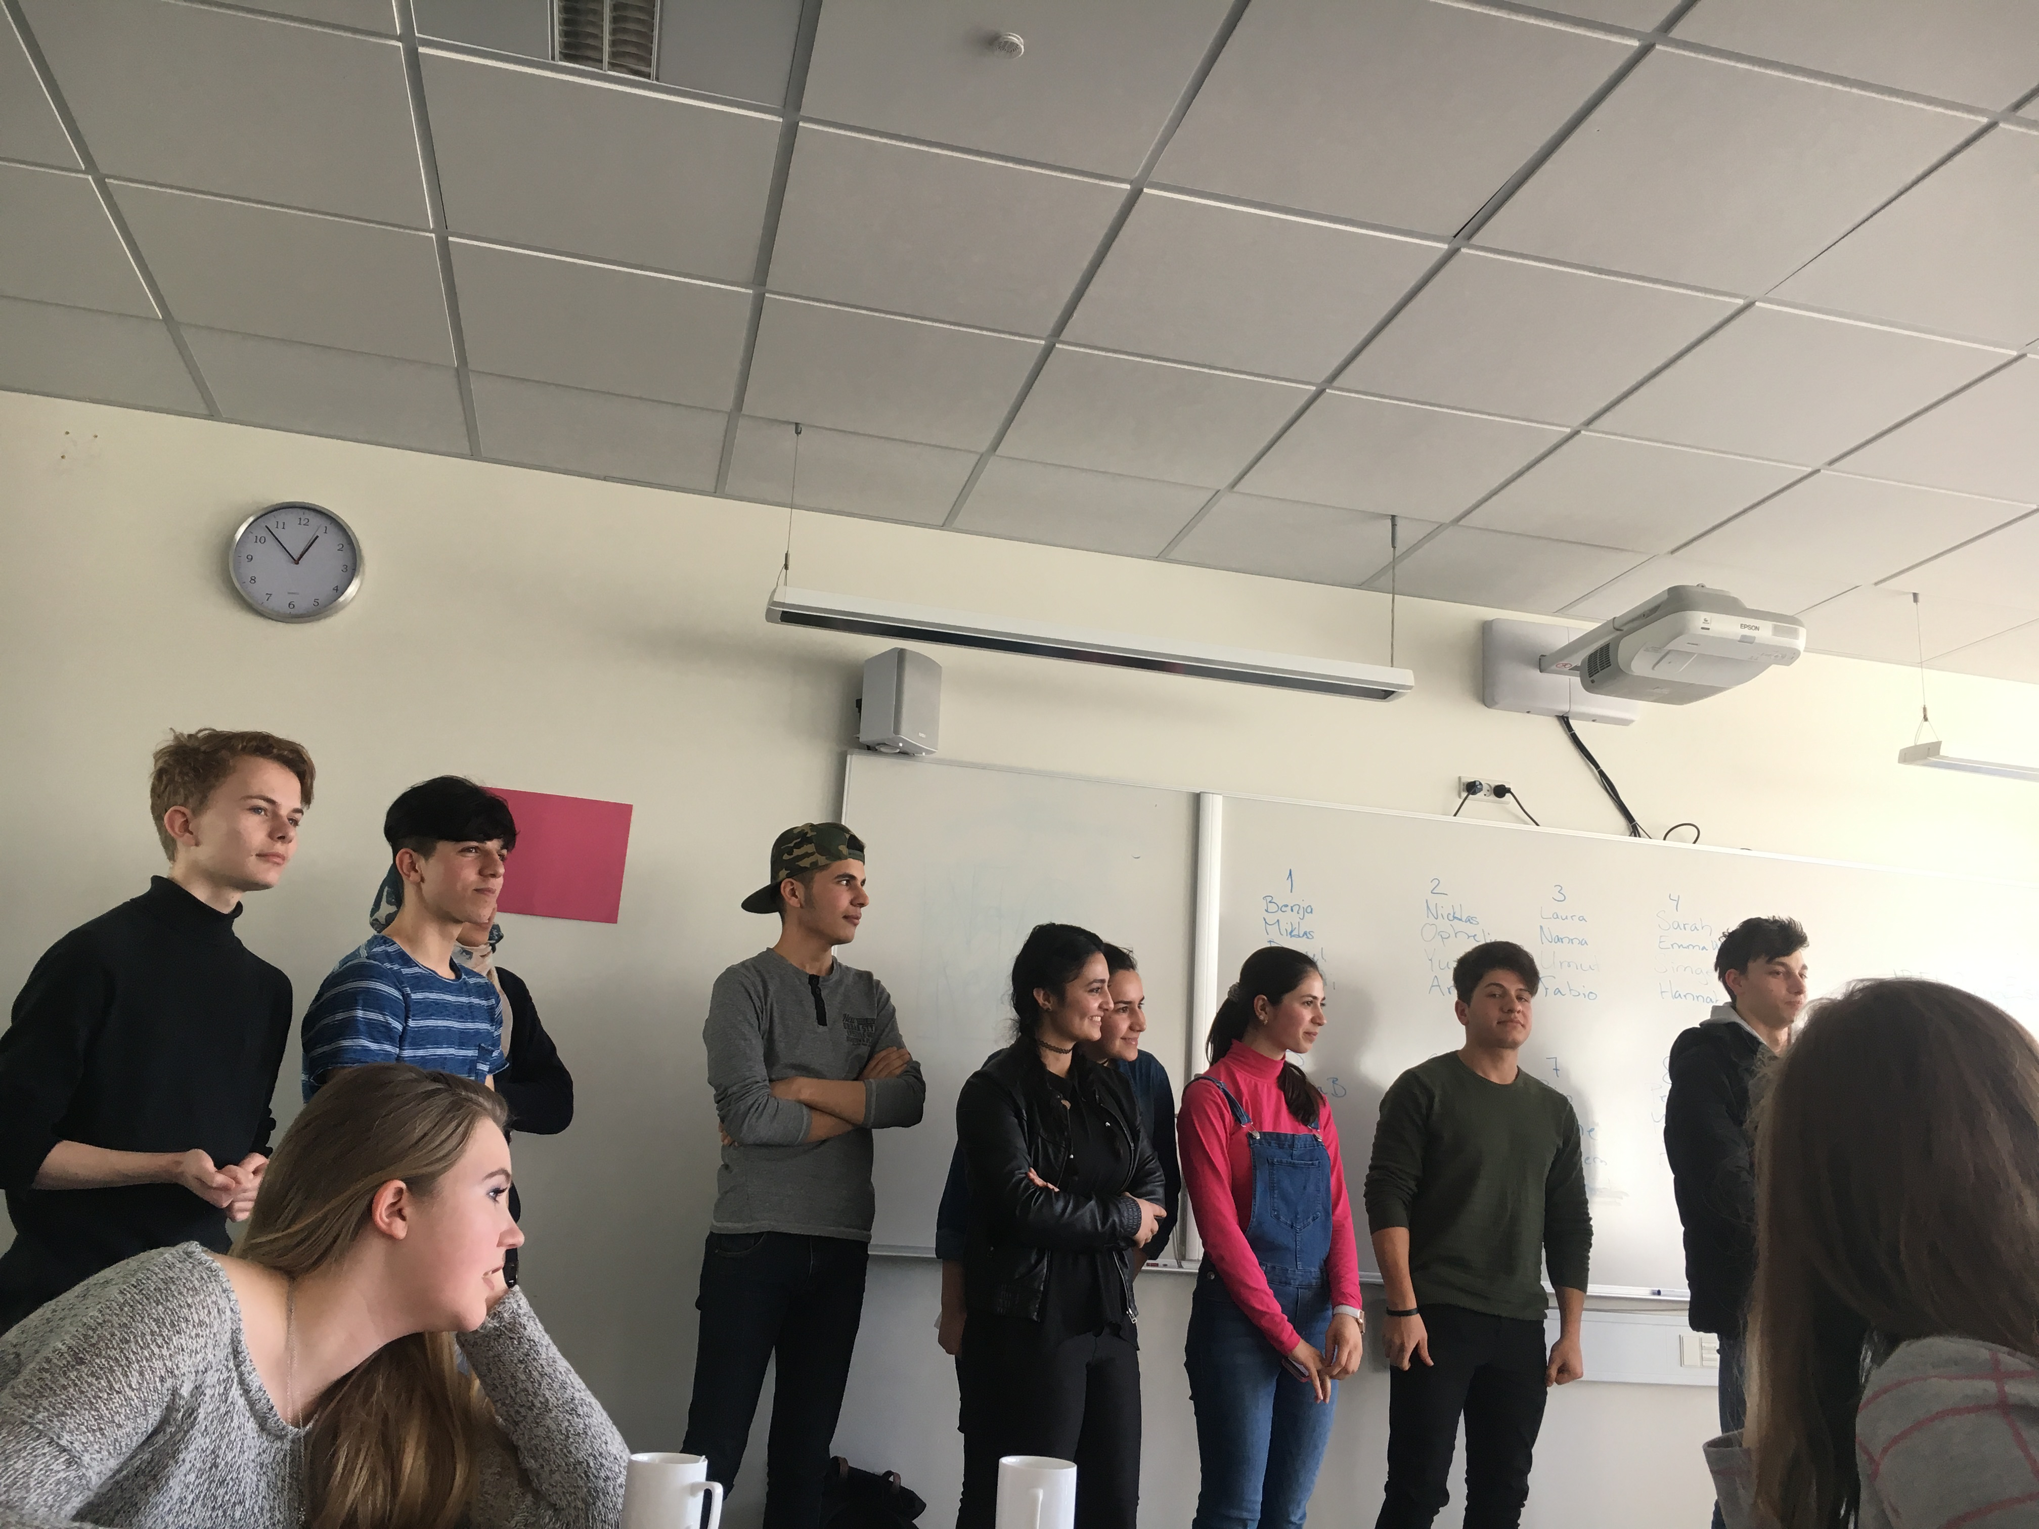
Meeting local refugees
We think that we have a lot of problems but they are humans with real problems, who miss their family, their country. They are strong personos.
I learned to be better with others, to listened others when they talk about their problems and to be thankful for what I have.

Slide 10
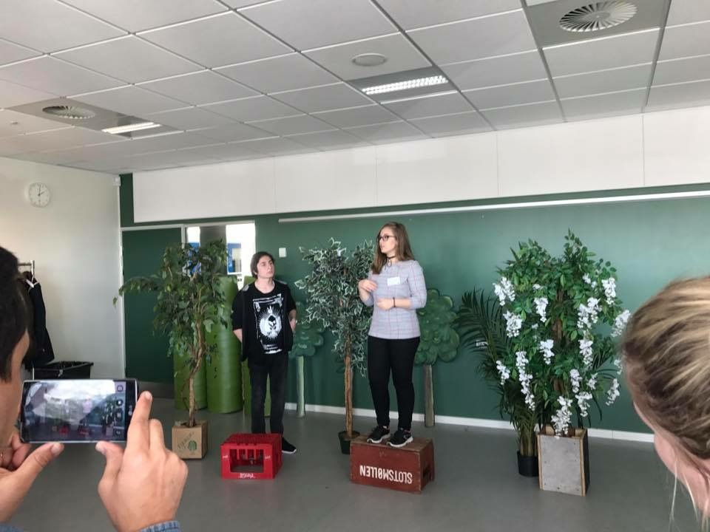
WORK SHOP: Speakers' corner-like in
Hyde Park in London
Here, everyone supported his opinion about an idea like: it is good to be an immigrant, it is good to read book, not to stay on the internet and another ideas. When someone spoke, a person was able to interrrupt.

Slide 11
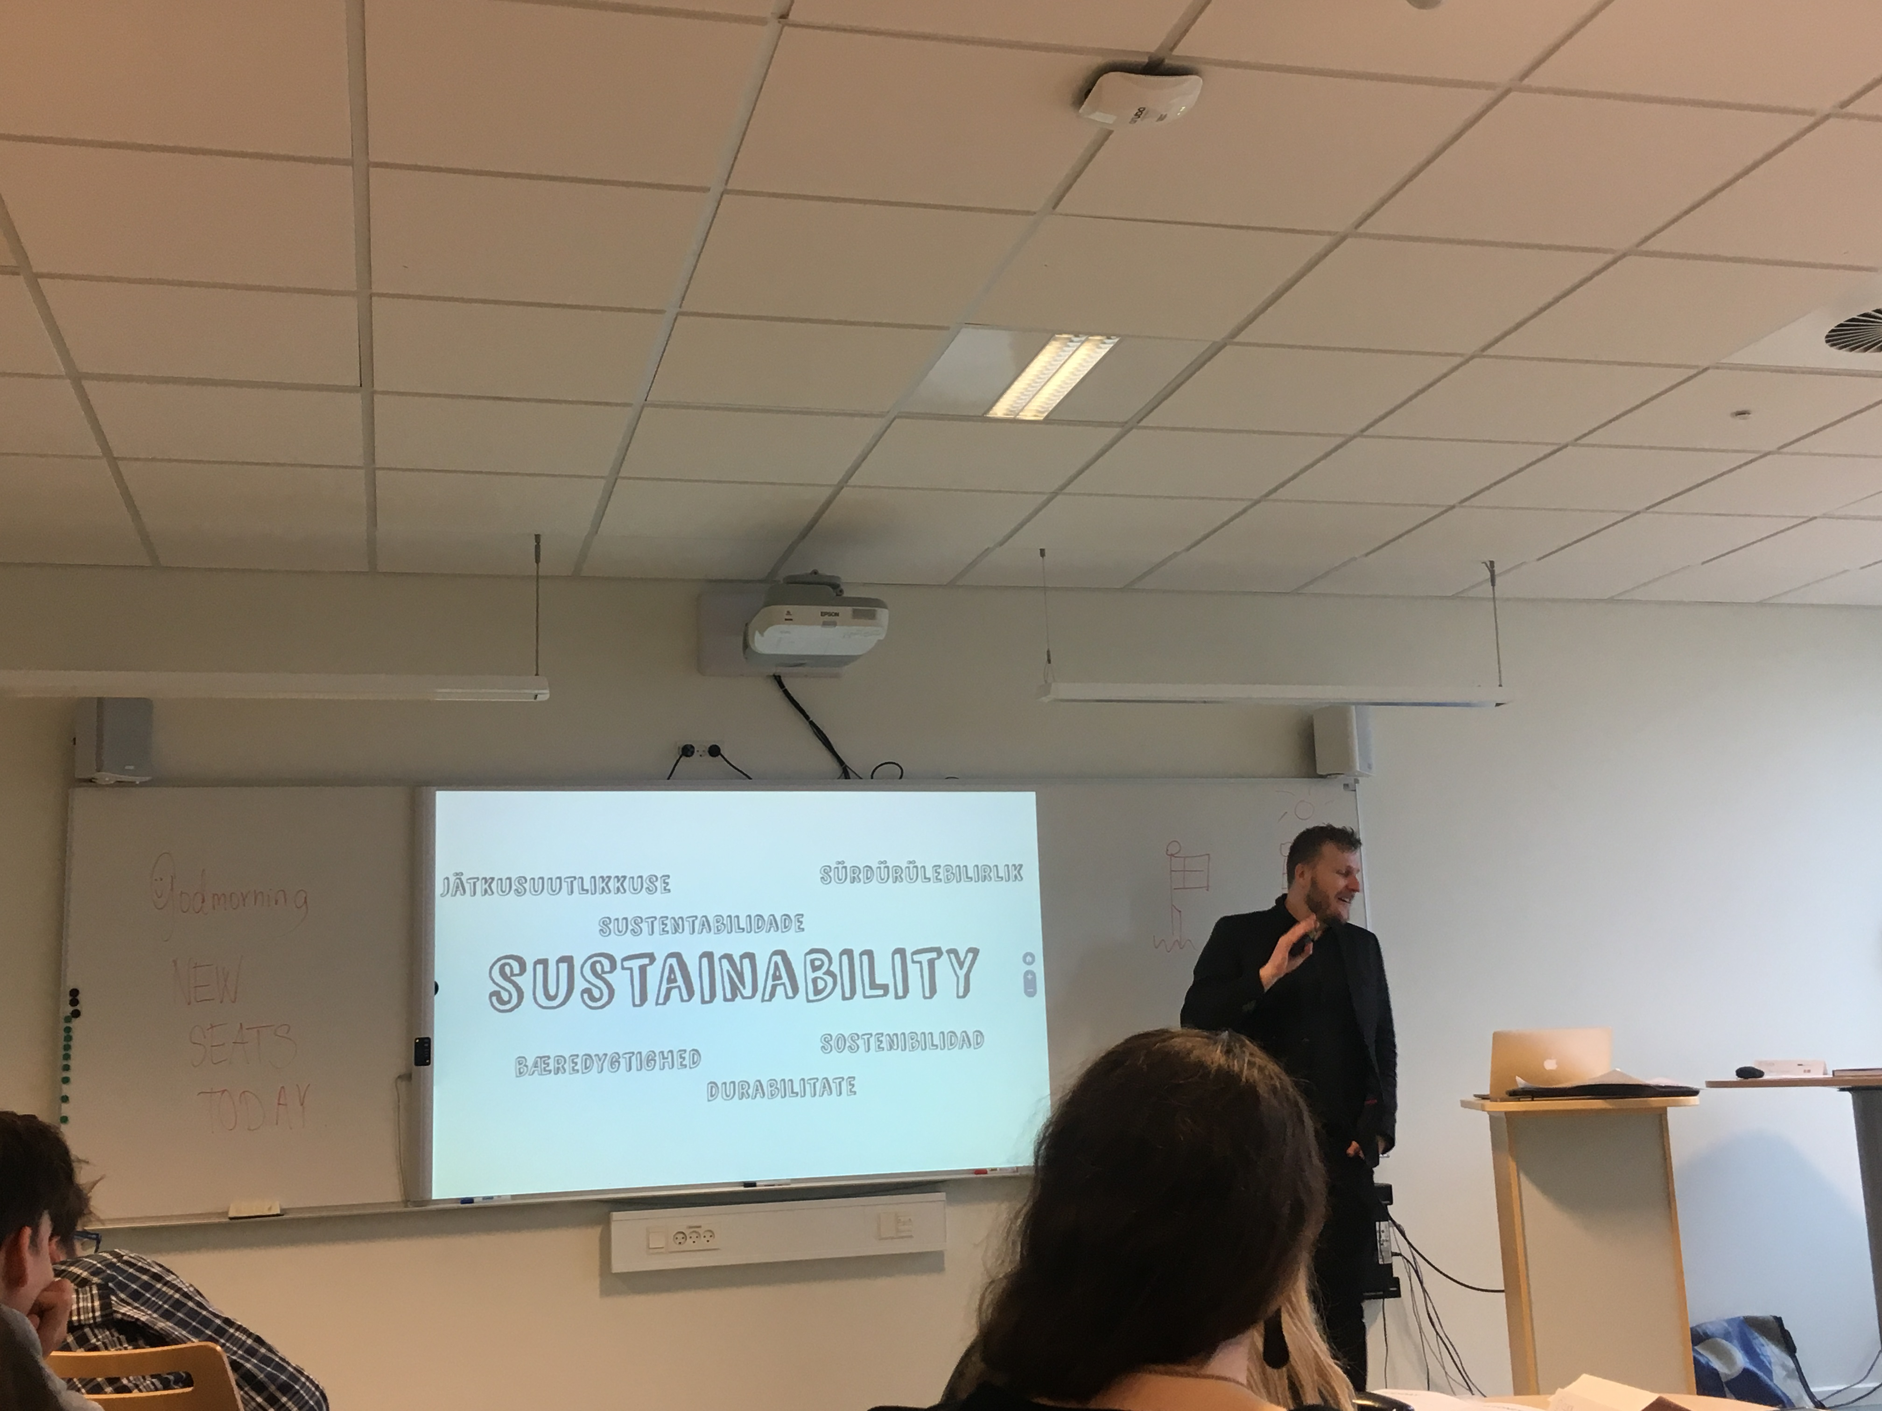
WEDNESDAY
The 29th of March 2nd CASE STUDY
Citizenship and democracy
Here we learned about citizenship and democracy, how to identify the importance of different political opinions and how to be a responsible citizen in a globalized world.

Slide 12
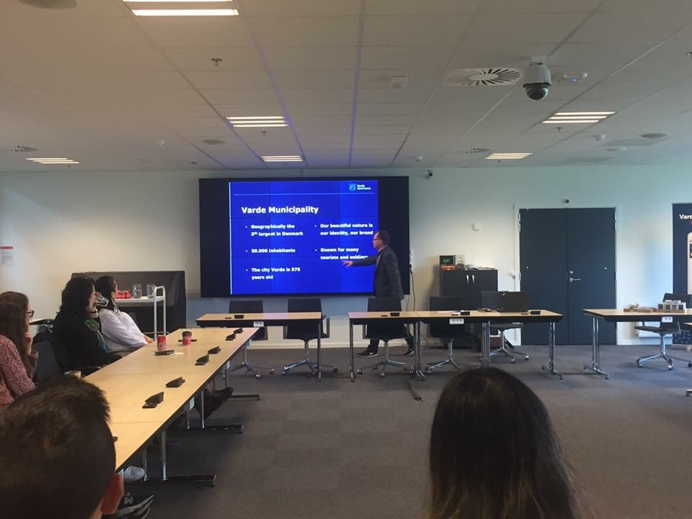
FIELD TRIP
We had to visit the local town hall where we were introduced to the mayor, Erik Buhl. There we found out how big is Varde, how much is invested in the town and how the mayor created jobs for citizens.

Slide 13
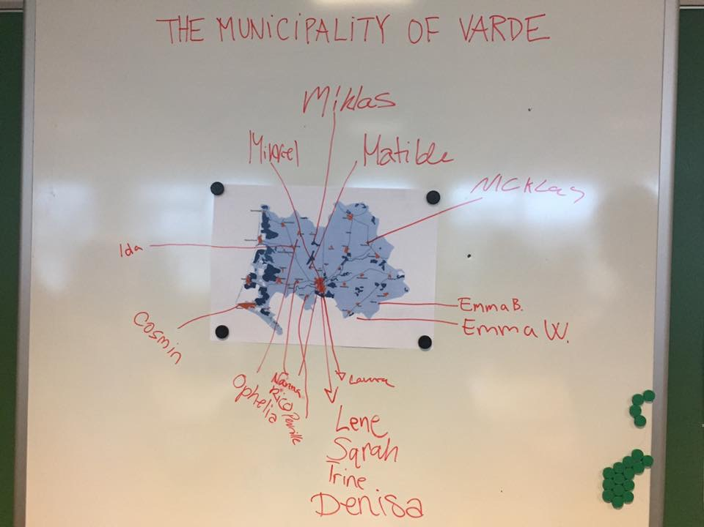
After the little trip on the local town hall, every teacher and every student from Denmark show us where they live on a map. We saw how close or how far they stay from school.

Slide 14
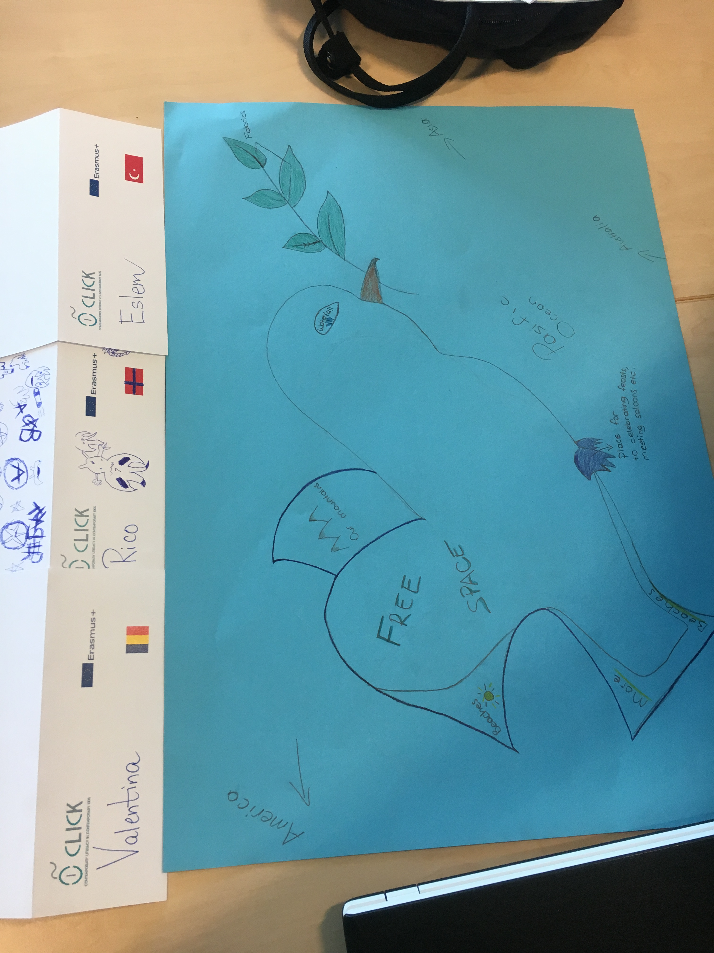
WORK SHOP: The ideal country of
C.L.I.C.K
In my team was 2 people without me and we agreed each other. Our country is named Narnia and for us it is the ideal country where all are equal, all are citizens, all have a house, a job, money, time for family and peace represent our country.

Slide 15
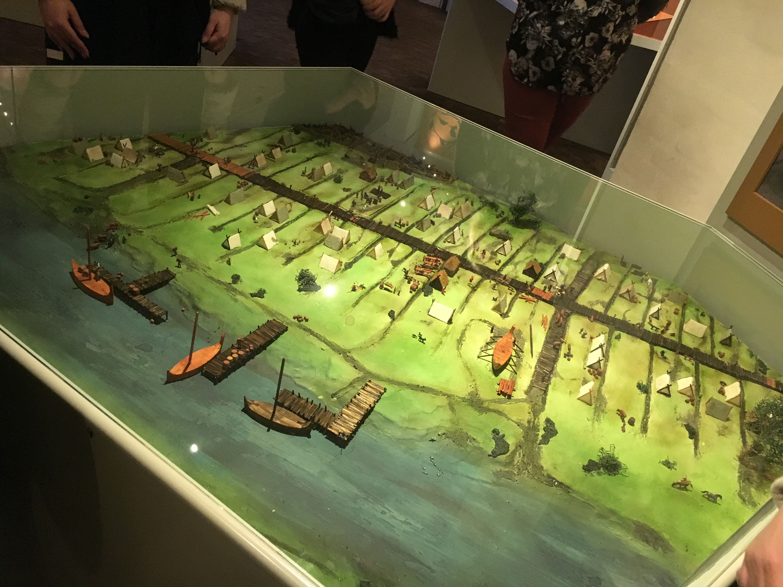
THURSDAY
The 30th of March
TRIP
Ribe is Denmark's oldest town-the town by The Wadden Sea National Park.
We start the trip with a little visit to a special Danish school for young people aged 18-25 years.
The second stop was at a historic museum: "Ribes Vikinger". The museum consists of a walk through the Wiking Age of Ribe and the Middle Age of Ribe.

Slide 16
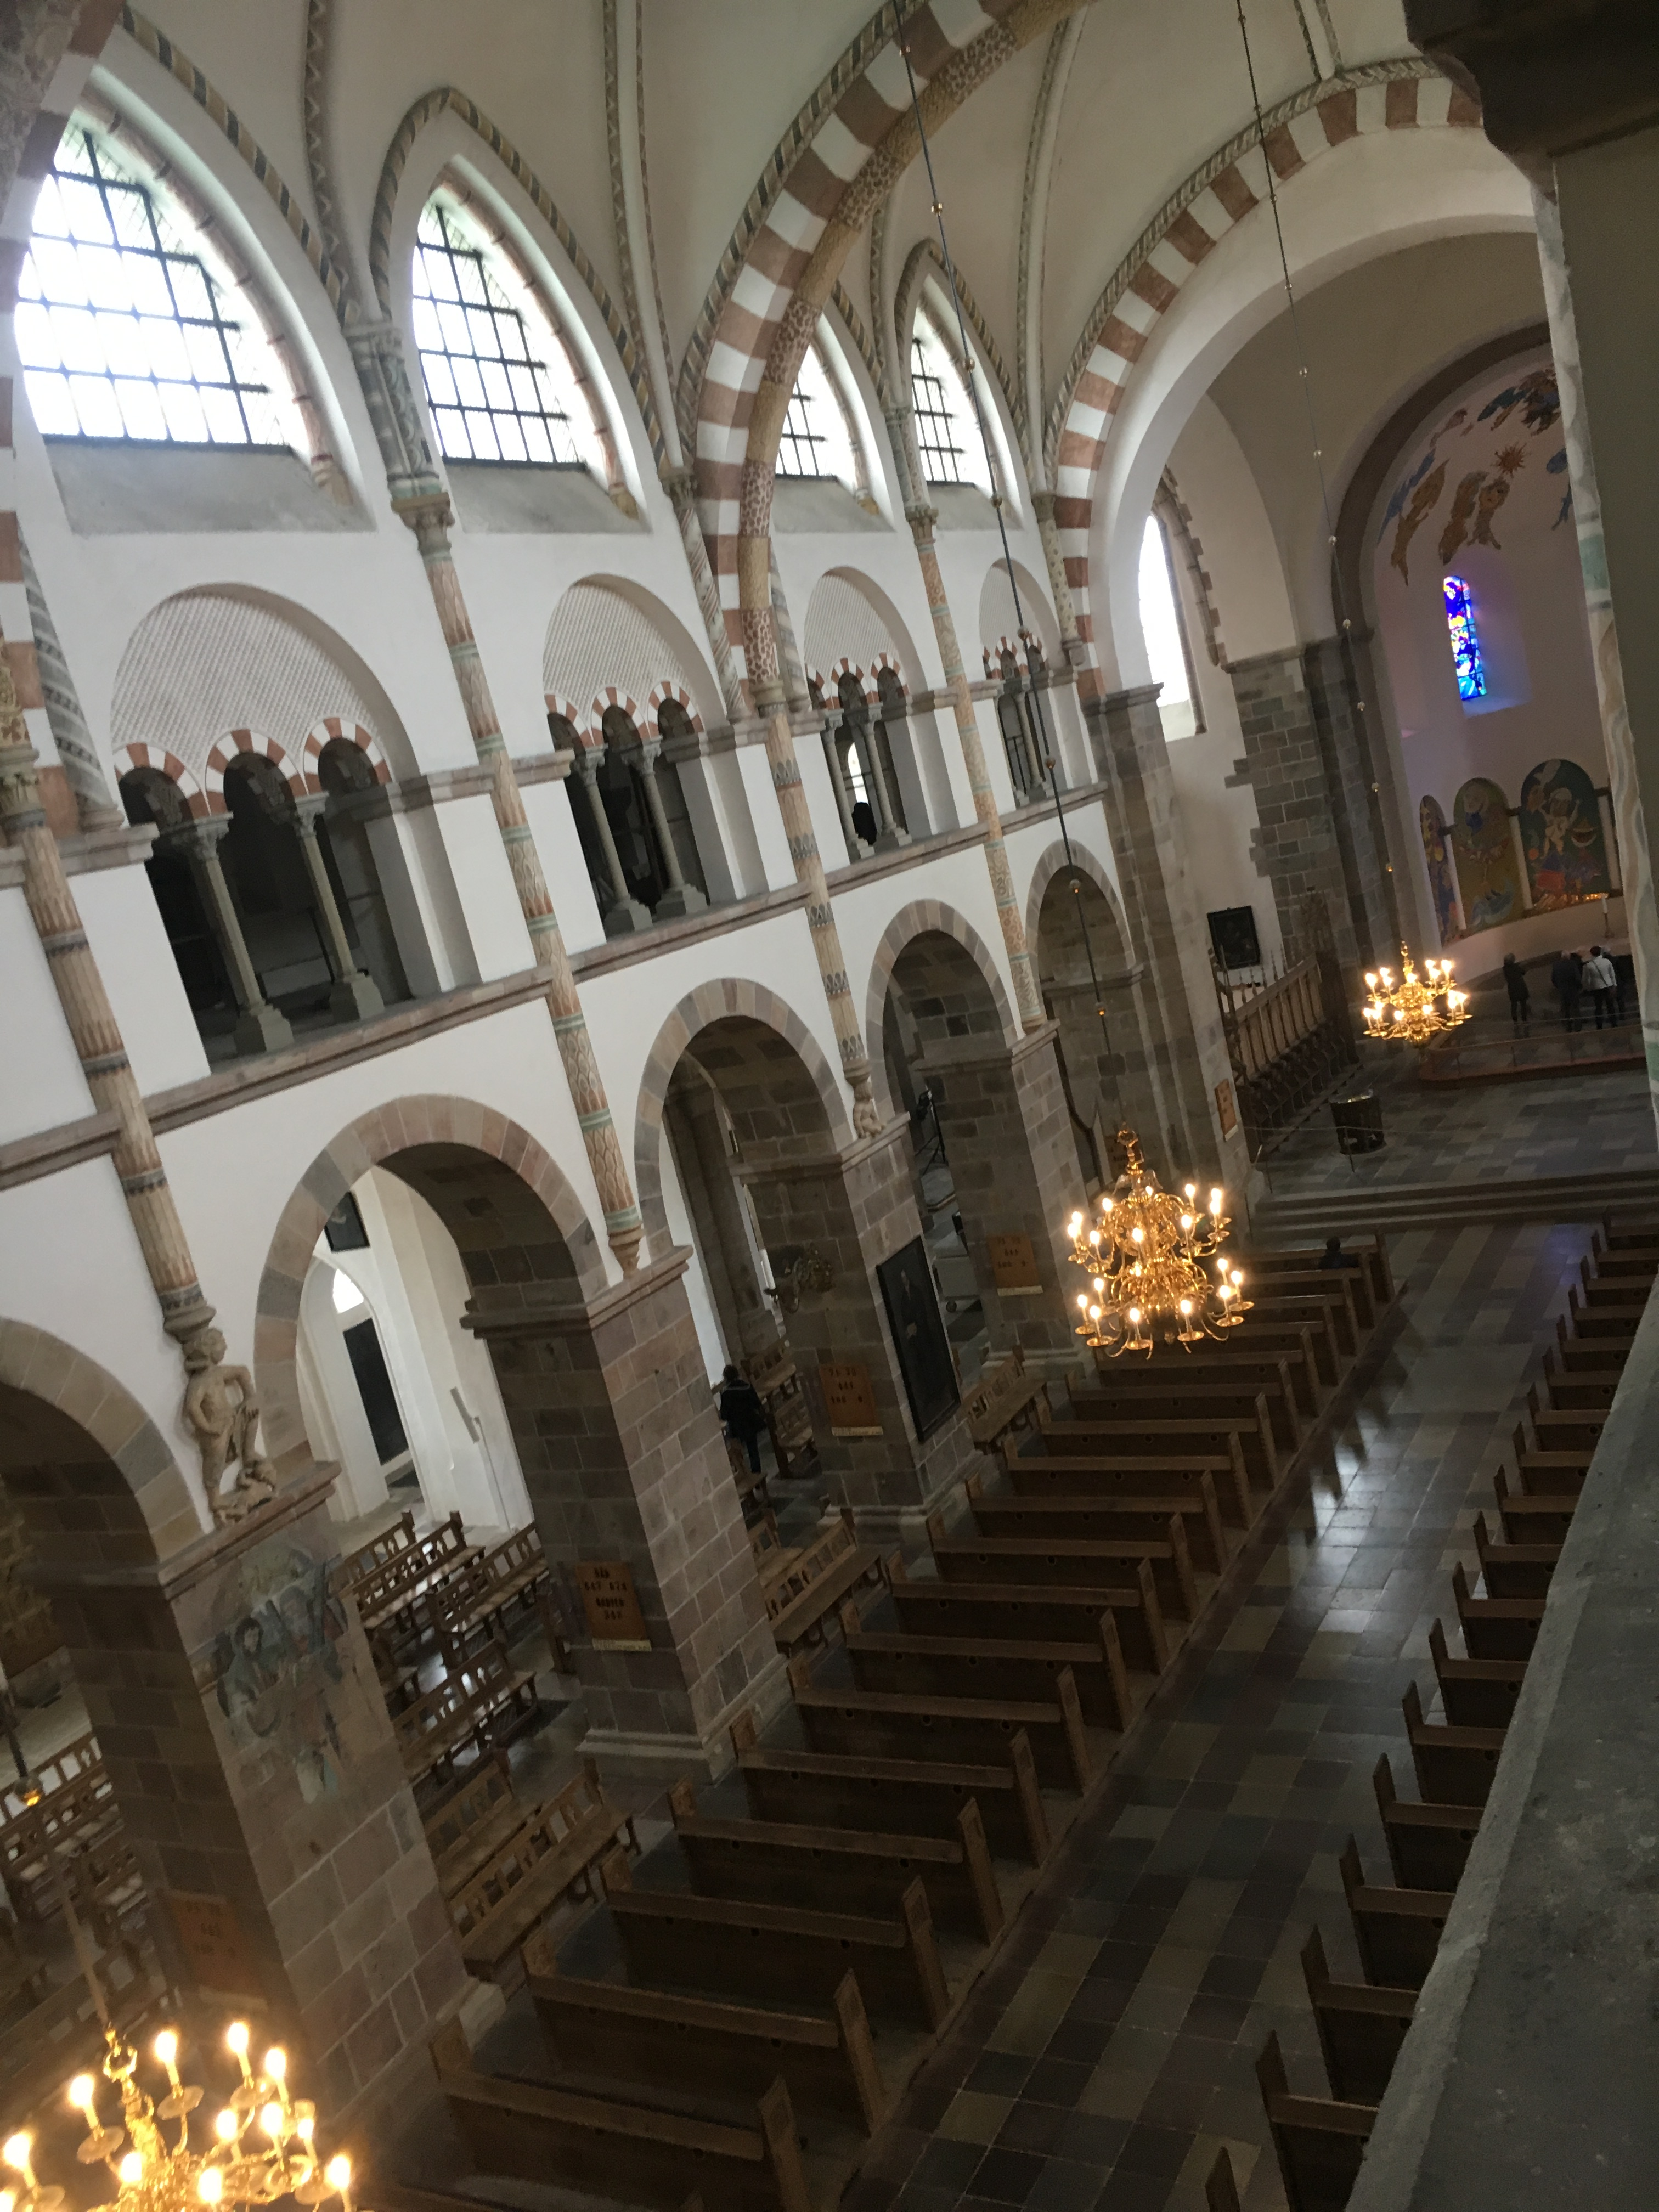
We walked down to the hostel in Ribe where Kirsten Margrethe Andresen made a presentation, who is married to the Bishop of Southern-Jutland and used to work as a priest, but now teaches religion at the university to become a teacher. She told us abaout the church and the government in Denmark.After, we visited the Lady Maria Cathedral. We were inside the tower, in which is a small museum.

Slide 17
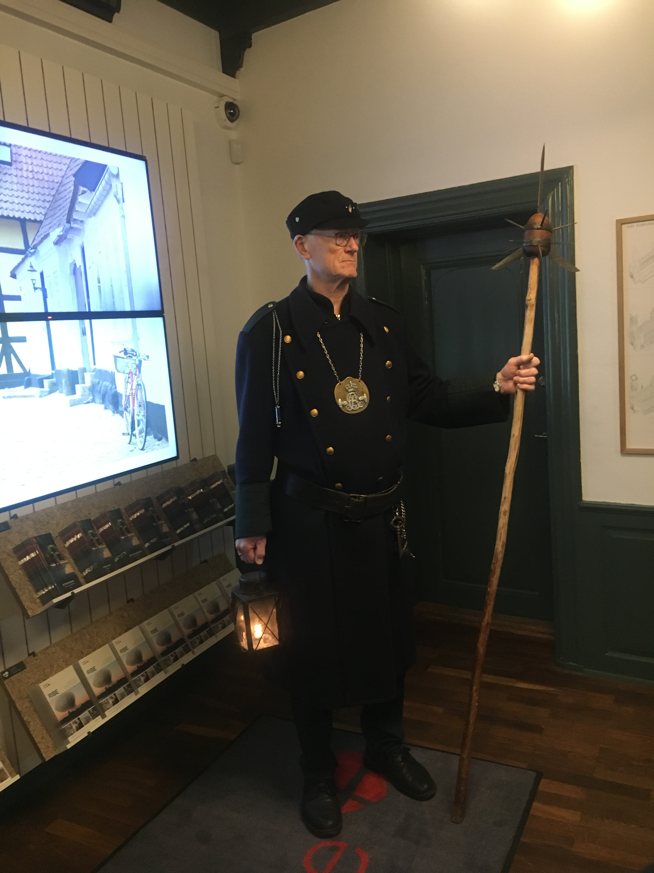
After we visited the Cathedral, we went back to the hostel where we met Laura, a young person and very active in politics. She is a part of a youth party called "Liberal Alliance".
We went to a Danish theatre-club called "Drakomir". They told us about politics connected with a theatre organization.
We met a watchman, he told us about Ribe, its history and tradition and he sang to us. Afterwards, we walked around the historic streets and alleys with him.

Slide 18
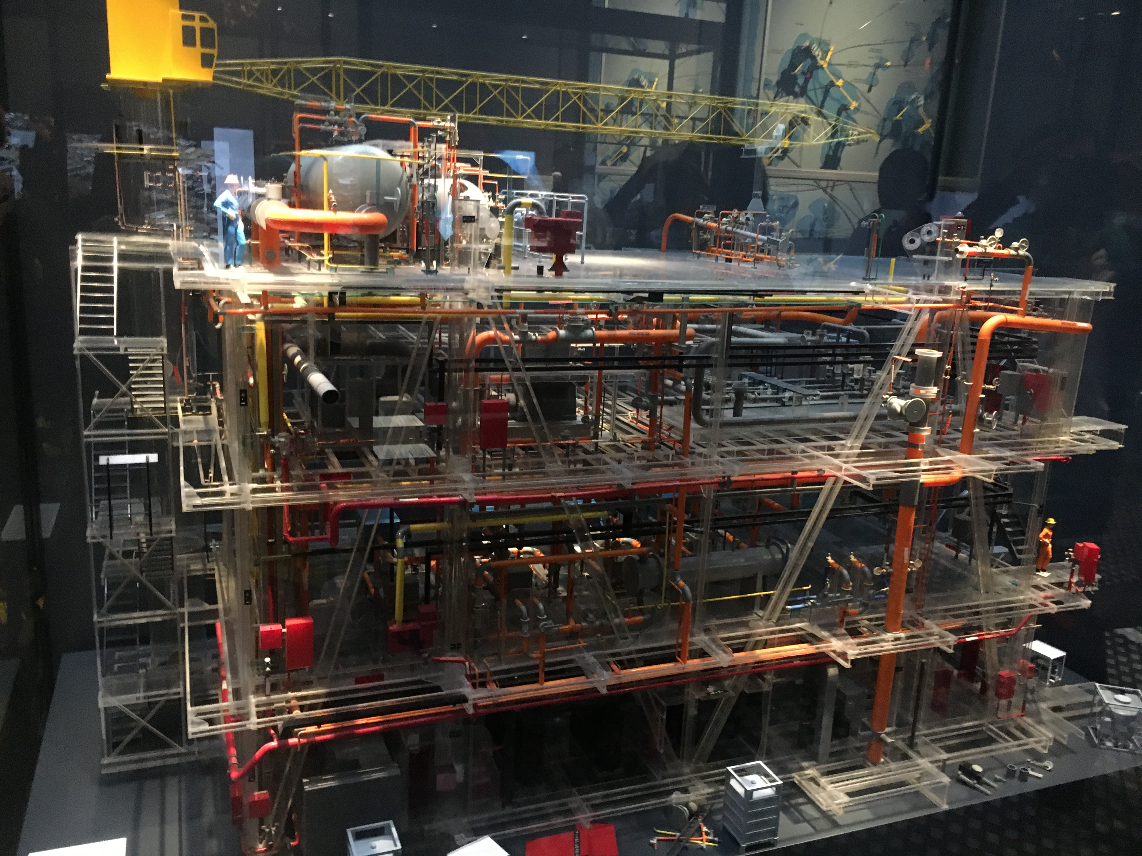
FRIDAY
The 31th of March
Two teachers came to our table to hear about our country and after to say their opinion about the ideal country made by us.
We got our certificate for the project.
We went to Esbjerg's Fisheries and Maritime Museum to see the exhibition "Energy from the sea"-Danish-Off-Shore in the North Sea which is an introduction to oil and wind energy in Denmark.

Slide 19
