Slide 1



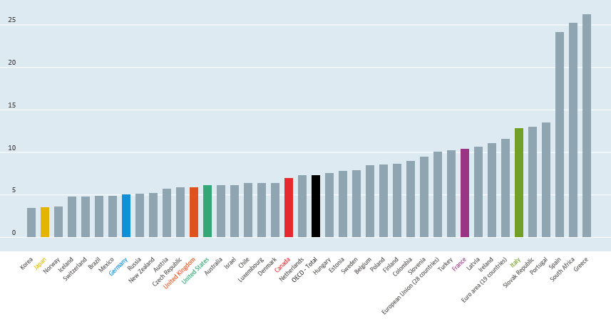

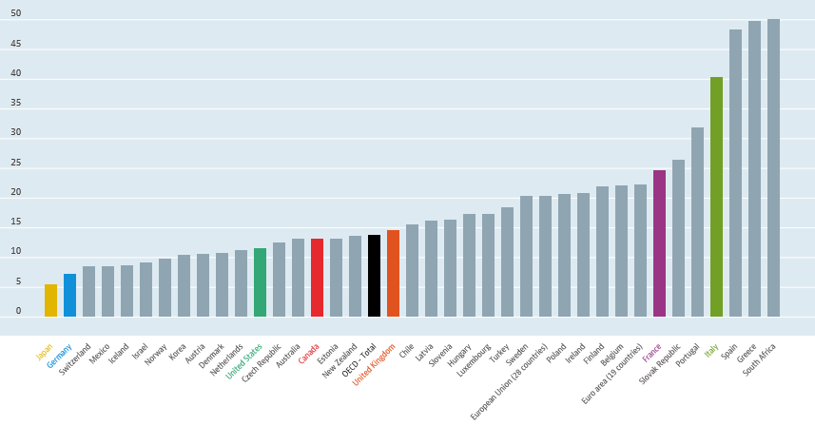


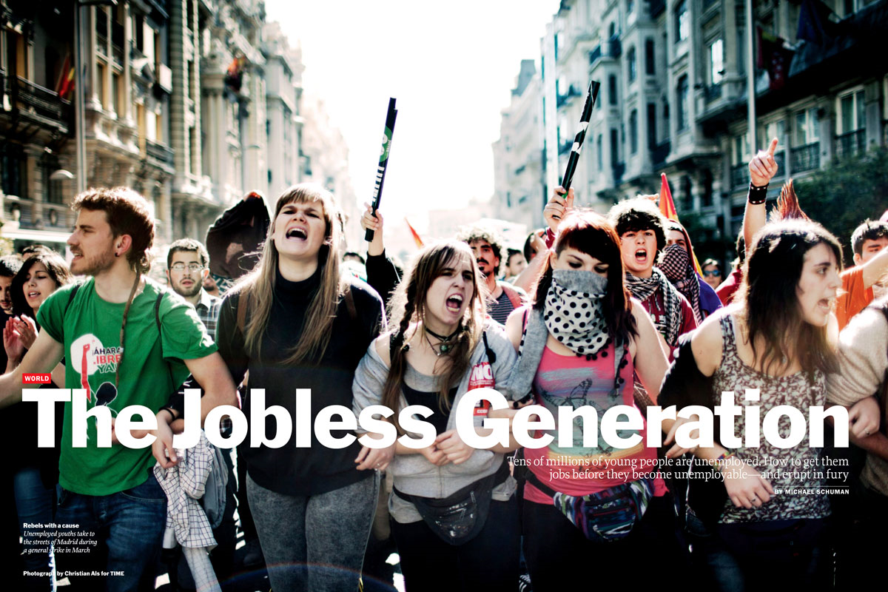
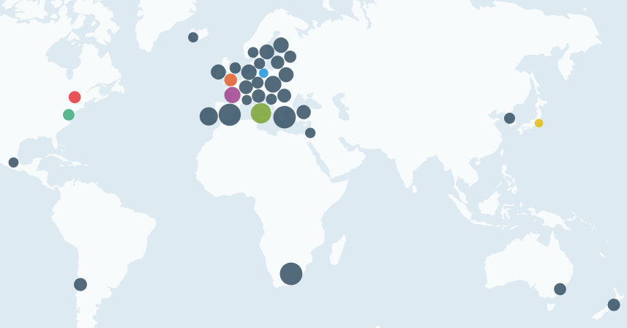
NO COUNTRY FOR YOUNG PEOPLE ?
Youth Unemployment in Germany
Simge YILDIZ, Şevval ŞENKUL , Kaan Taceddin ARDA, Yusuf GENCER
Tevfik Seno Arda Anadolu Lisesi
the Problem
A Case Study
Solutions
An unemployed person is defined as someone who does not have a job but is actively seeking work. Unemployment is a serious problem that affects millions of people all around the world.
Youth unemployment is the unemployment of young people, defined by the United Nations as 15–24 years old.
Youth unemployment rates are historically four to five times more than the adult rates in every country in the world.
In the OECD as a whole, 15 million young people are unemployed representing around $300 billion in lost wages alone, over a full year.
There are 1.2 billion youth in the world aged between 15 and 24, accounting for 17% of the world's population. 87% of them live in developing countries.
This case study focuses on an economic and social problem : youth unemployment in Germany . The reason why Germany has been selected is its relatively low unemployment rate .
OECD statistics indicate unemployment rates for youth aged 15-24 of ,
For Germany 8.2% (2012)
7.9% (2013)
an OECD average of about 16%
an EU average of around 23%
Early Labour Market Integration: The firm-based
training includes the practical part of the training, while the schools are responsible for theoretical and general education. Usually, trainees spend one or two days per week in school. Part-time vocational schools and firms are by law defined as equal partners in training.
Corporatist Regulation : the German system of vocational education is backed by the social partners, who play an active role in its development.
Occupational Profiles : It is the respective training stages and the necessary supplements of subject-specific theoretical knowledge and general education.
Training Policies: The Establishment of the Transition System. It encompasses all kinds of training, education and labour market schemes meant to facilitate the transition from school to
training, but do not provide approved vocational qualifications.
German companies launch campaigns such as the pan-European "InCharge" initiative to motivate and enable unemployed young Europeans to train and find a job in Germany.
This case study tries to show recent developments in German youth unemployment and looks at the mechanisms behind the low unemployment which may provide a good example and possible solutions for the countries which face with the same problem.
Causes and Consequences
Youth Unemployment Causes
Financial crisis
The quality and relevance of education
Inflexible labour market and regulations
Skills mismatch
Lack of entrepreneurship and lifes kills education
Lack of access to financial support
A digital divide
Youth Unemployment Consequences
A lost generation
Political unrest and increased public spending
A lack of innovation
Incarceration and mortality
Advice
Improving primary education and decreasing early school leaving.
Establishing stronger links between schemes of
the transition system and the regular training system.
Establishing more efficient schemes.
Guaranteeing access to regular training.
Teaching 21st-century skills
References
KOHLRAUSCH,B.(2012). Youth Unemployment in Germany Skill Biased Patterns of Labour Market Integration
Peace Child International Future Business Centre. http://peacechild.org/youth-unemployment-causes-and-solutions/
Dolado, J.(2015) . Youth Labour Market Problems in Europe
https://en.wikipedia.org/wiki/Youth_unemployment

