Slide 1
Invictus
Reflecting on a 2009 American-South African biographical sports drama film directed by Clint Eastwood and starring Morgan Freeman and Matt Damon
Year 10 students at Tartu Tamme Gymnasium
24 May 2019

Slide 2
Group 1 presentation
Social prejudice
Delivered by
Marie Femke, Marielle, Emili and Andrea

Slide 3
Group 2 presentation
Inspiration
Delivered by
Karoliina, Karoli, Johanna, Kristin and Isabella

Slide 4
Group 3 presentation
Forgiveness
Delivered by
Eliise, Markus, Rasmus and Mikk Marten

Slide 5
Group 4 presentation
Invictus
Delivered by
Juan, Roland, Robin and Ander Markus

Slide 6
Turn to your worksheet and complete Task 1.
While listening/watching the video, make as many notes as you can.
After listening/watching the video, discuss your answers with your group members and correct your answers.
The spokesperson of each group will then share the answers with the rest of the class.

Slide 7
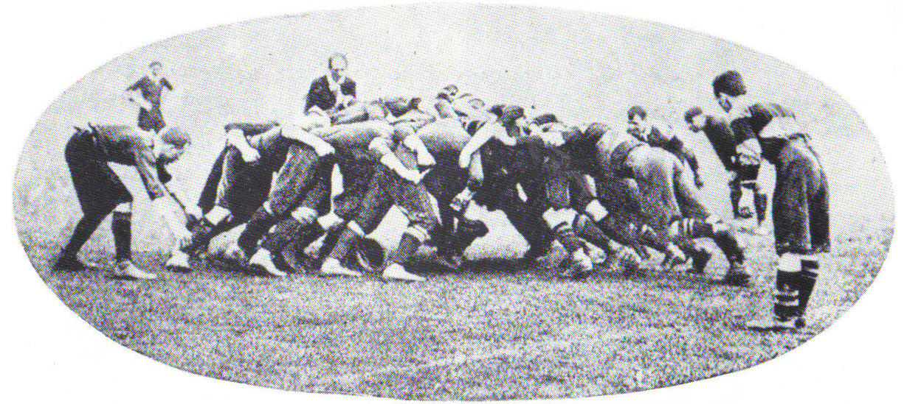
Rugby for beginners
https://www.youtube.com/watch?v=ke4XcnbulT0

Slide 8
Turn to Task 2. Focus on Clint Eastwood.
Find out information about the director of the film Invictus.
Use your mobile phone in order to consult the IMDb web (Ratings and Reviews for New Movies and TV Shows)
Discuss your answers in group.
Now watch the interview with Clint Eastwood.
Make notes.

Slide 9
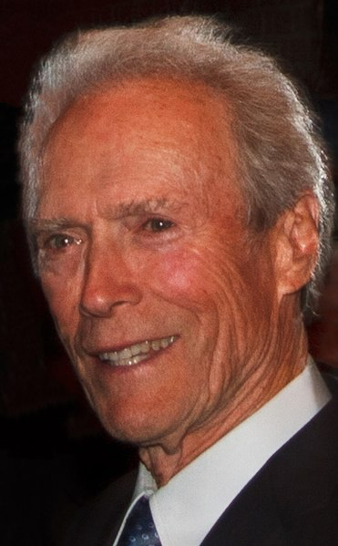
Clint Eastwood on directing Invictus
https://www.youtube.com/watch?v=pFLsHseMHvA

Slide 10
Focus on Morgan Freeman.
Find out information about the leading actor.
Use your mobile phone in order to consult the IMDb web (Ratings and Reviews for New Movies and TV Shows)
Discuss your answers in group.
Now watch the interview with Morgan Freeman.
Make notes.

Slide 11
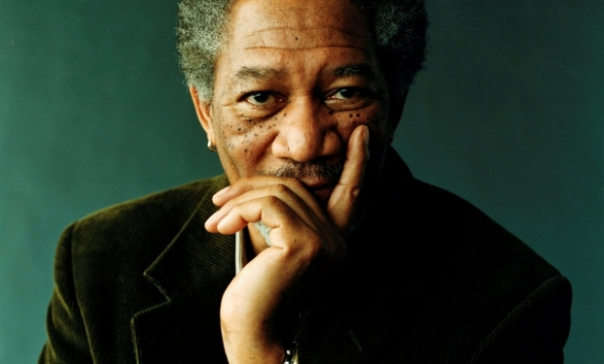
Morgan Freeman on Mandela
https://www.youtube.com/watch?v=d3dZngCraqs

Slide 12
Focus on Matt Damon.
Find out information about the leading actor.
Use your mobile phone in order to consult the IMDb web (Ratings and Reviews for New Movies and TV Shows)
Discuss your answers in group.
Now watch the interview with Matt Damon.
Make notes.

Slide 13
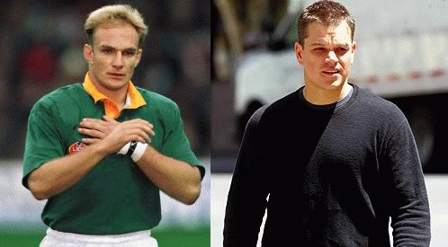
Matt Damon on Francois Pienaar
https://www.youtube.com/watch?v=J7JSwxFFSY8

Slide 14
Open discussion
Share your thoughts and ideas on Eastwood, Freeman and Damon, as well as what they said about the film and their characters.

Slide 15
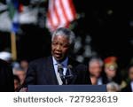
Nelson Mandela Speech That Changed The World
https://www.youtube.com/watch?v=x0w7EnExt5U

